Slide 1
Basic Electronics (3110016)
Prepared by : Dr. Neha Shah

Slide 2
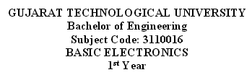
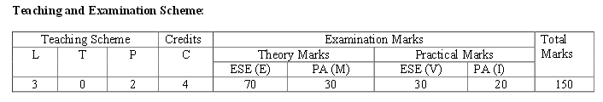
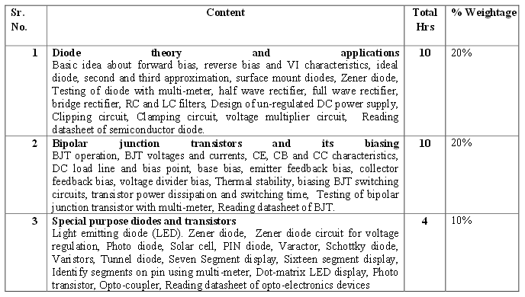

Slide 3
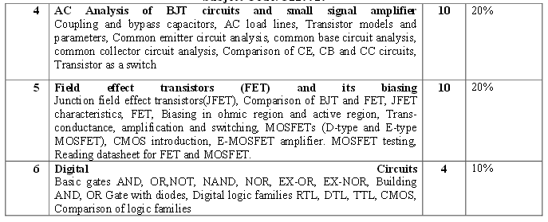
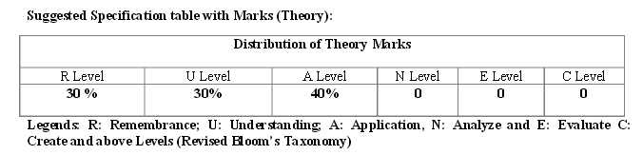

Slide 4
Conductor, Semiconductor And Insulator
The major difference between conductor, insulator and semiconductor is defined by the flow of charged particles under the influence of electric field.
When any voltage is applied to the conductor, electric charged particles easily flow from valence band to conduction band.
Thus conductor is a good conductor of electricity.
A semiconductor allows very low charge particles to move from valence band to conduction band.
In insulators, there is no flow of charge particles under the influence of electric field hence insulators are the bad conductor of electricity.

Slide 5
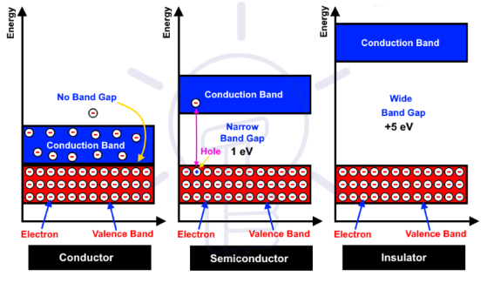
Conductor, Semiconductor And Insulator
Valence band is basically defined as the energy band that comprises of valence electrons present in the outermost shell of an atomic structure.
A conduction band is defined as that energy band that consists of free electrons that are responsible for conduction.
A band gap is an energy range in a solid where no electron states can exist due to the quantization of energy

Slide 6
Conductors
Materials through which charge flows readily are called conductors.
A conductor has a very low resistance to the flow of charge.
Ex. Silver, gold, copper, aluminum and such metals. Copper is used mostly for the conductive paths on electric circuit boards and for the fabrication of electric wires.
Insulators
Materials that do not allow charge to move easily. Electric current cannot be made to flow through it.
An insulator has very high resistance to the flow of charge.
Ex: glass, plastic, ceramics and rubber. Insulating materials wrapped around the conducting core of the wire.
Semiconductors
Semiconductors lie in the middle between conductors and insulators
Semiconductor has moderate resistance to the flow of charge.
Ex. Elemental semiconductors are Silicon, germanium whereas gallium arsenide is an example of compound semiconductors which are developed.

Slide 7
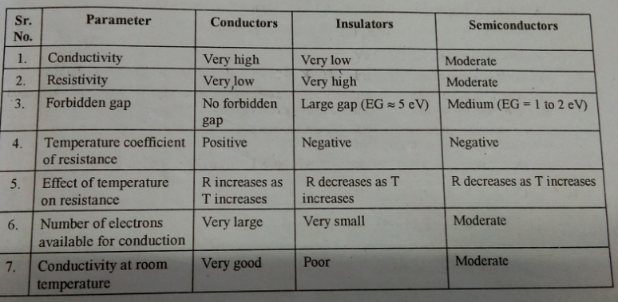
Difference between Conductor, Semiconductor And Insulator

Slide 8
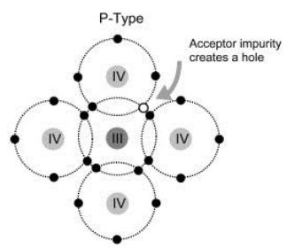
P type Semiconductor
The P-type semiconductor can be formed by adding trivalent impurities.
Silicon that has been doped with a trivalent impurities like aluminum, boron and gallium is called a p - type semiconductor, where the p stands for positive.
Once the impurity is added, then it creates holes or vacancy of electrons. So this is called an acceptor atom.
The majority charge carriers are holes & minority charge carriers are electrons.

Slide 9
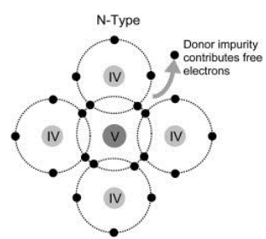
N type Semiconductor
The N-type semiconductor can be formed by adding pentavalent impurities.
Silicon that has been doped with a pentavalent impurities like arsenic, antimony and phosphorus is called an n-type semiconductor, where the n stands for negative.
Once the impurity is added, then it gives extra electrons. So this is called a donor Atom.
The majority charge carriers are electrons & minority charge carriers are holes

Slide 10
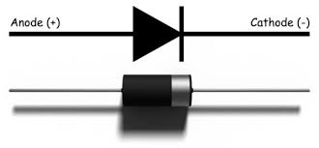
Diode

Slide 11
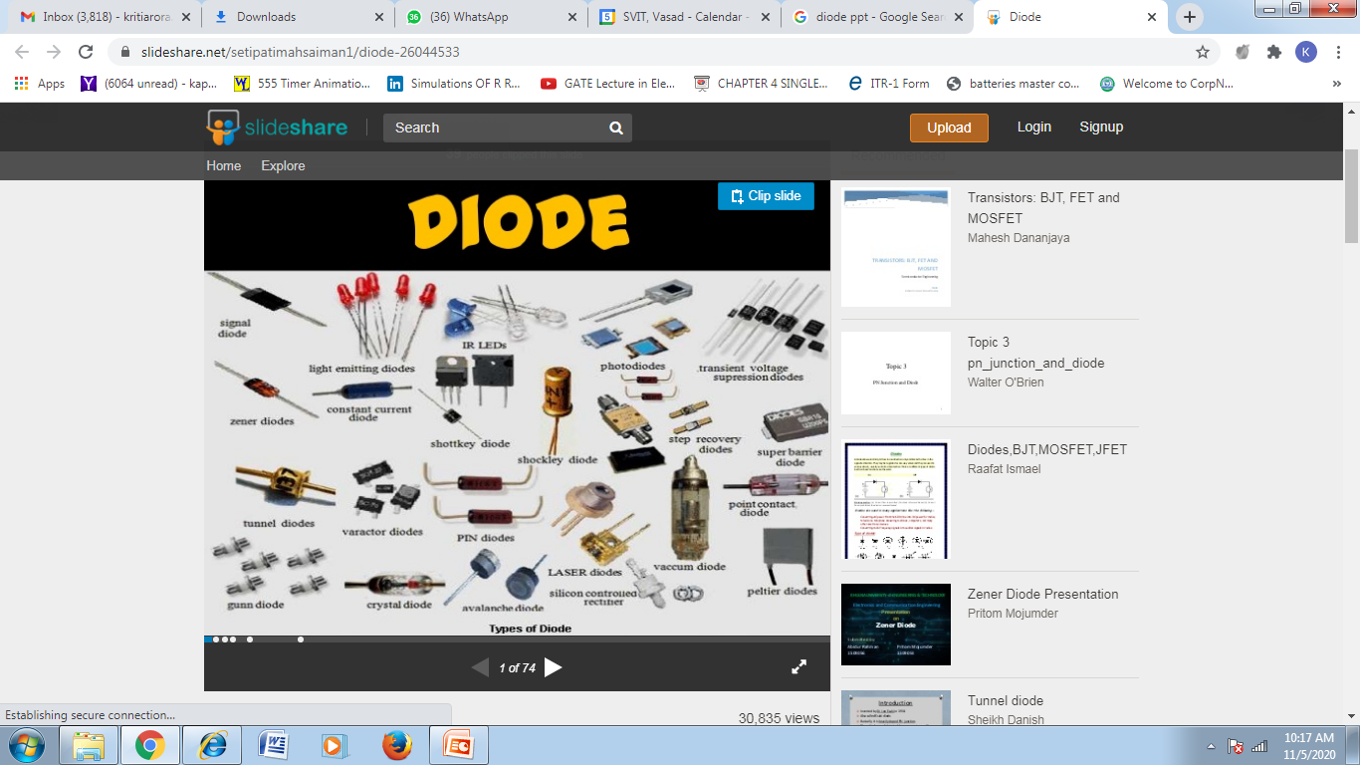

Slide 12
Diode
A diode is defined as a two-terminal electronic component that only conducts current in one direction (so long as it is operated within a specified voltage level).
An ideal diode will have zero resistance in one direction, and infinite resistance in the reverse direction.

Slide 13
Diodes
Semiconductor diodes are the most common type of diode. These diodes begin conducting electricity only if a certain threshold voltage is present in the forward direction (i.e. the “low resistance” direction).
The diode is said to be “forward biased” when conducting current in this direction. When connected within a circuit in the reverse direction (i.e. the “high resistance” direction), the diode is said to be “reverse biased”.

Slide 14
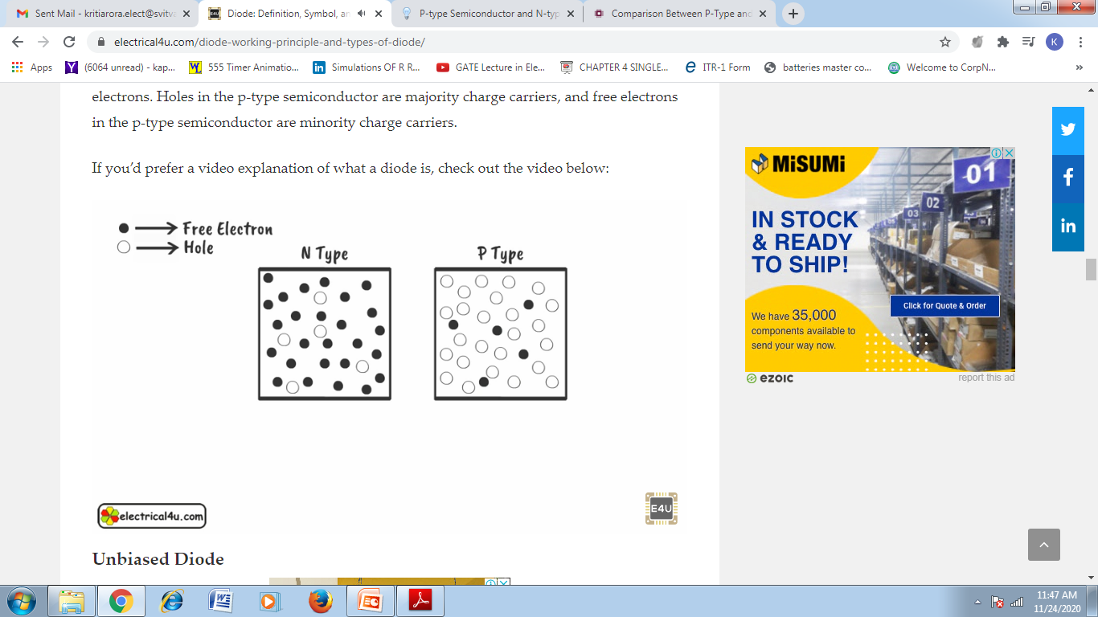
P and N type material

Slide 15
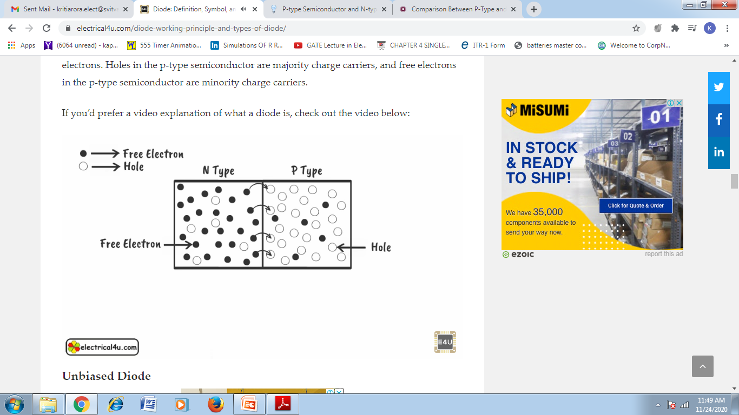
PN Junction

Slide 16
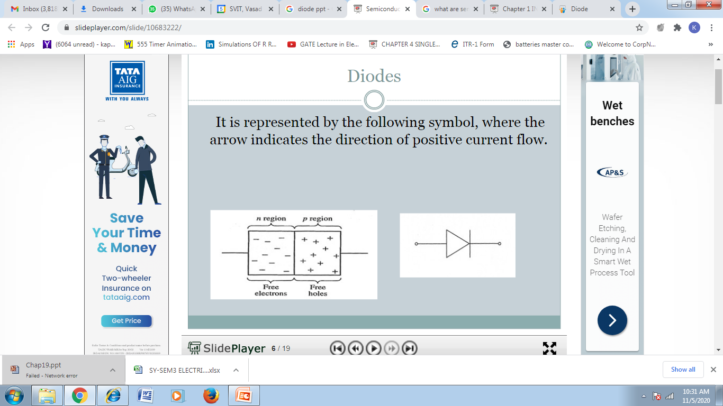
Diodes

Slide 17
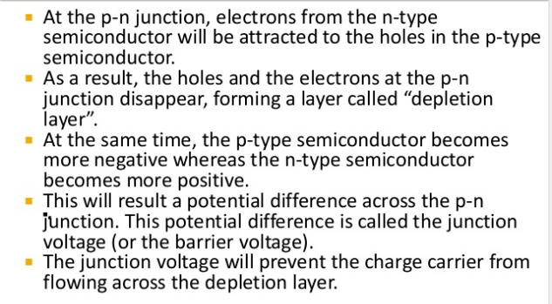
Depletion Region And Junction voltage

Slide 18
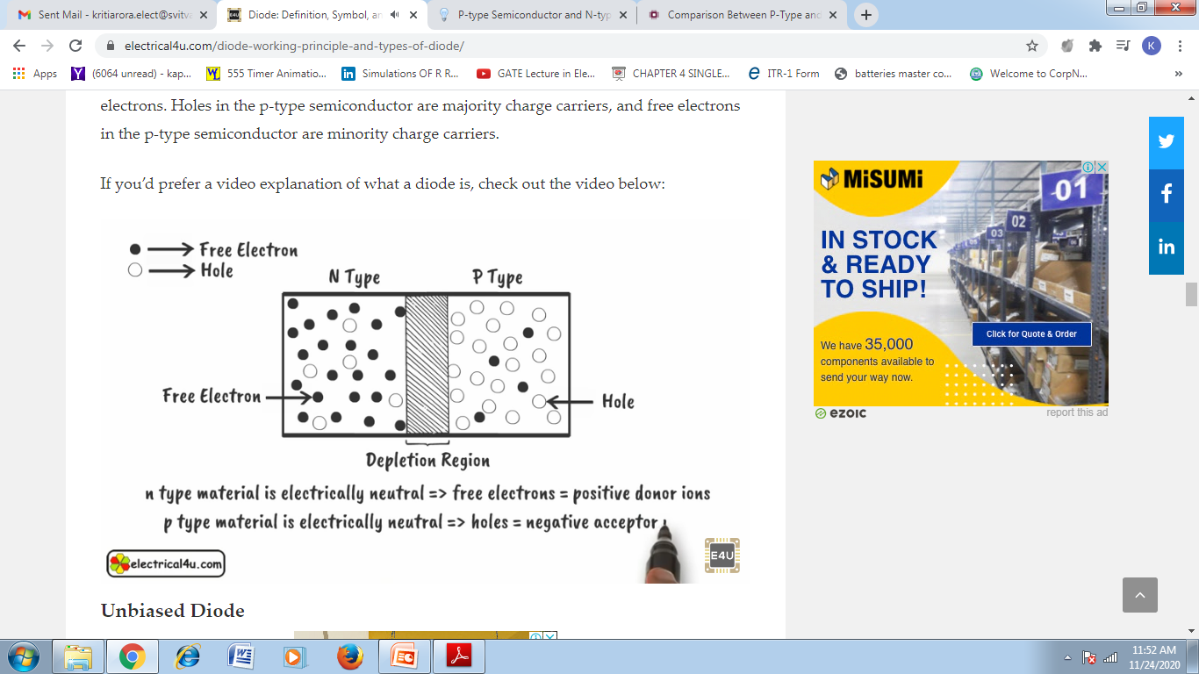
Depletion Region

Slide 19
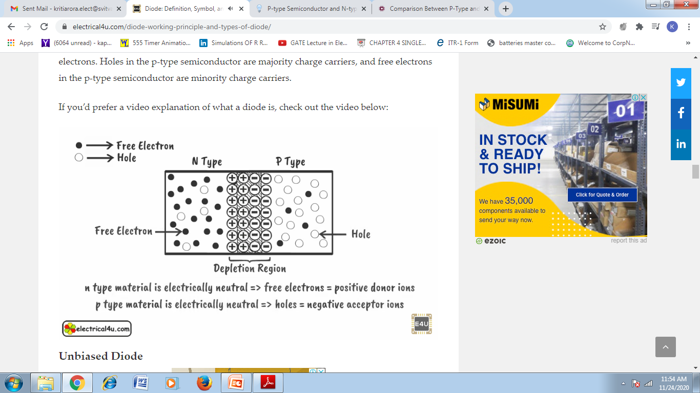
Depletion Region

Slide 20
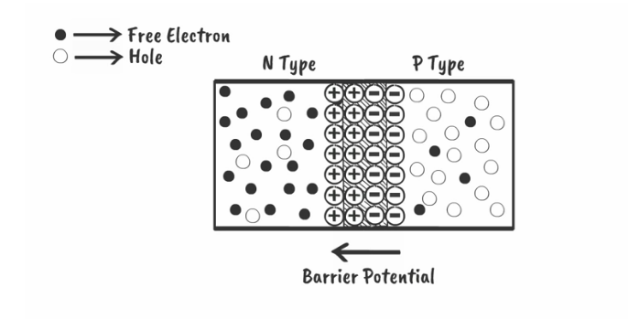
Barrier Potential/Junction Voltage

Slide 21
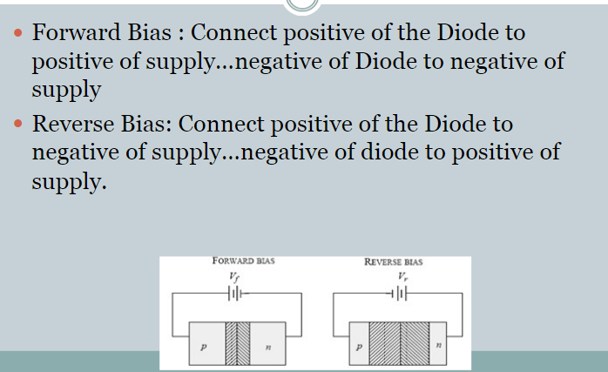
Forward bias And Reverse Bias

Slide 22
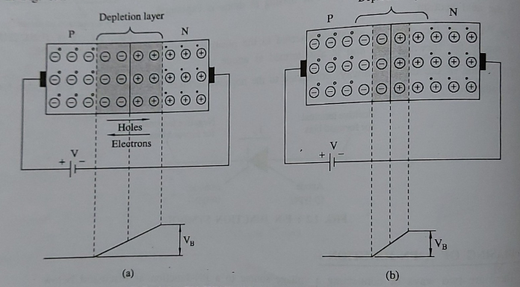
PN junction Forward Bias

Slide 23
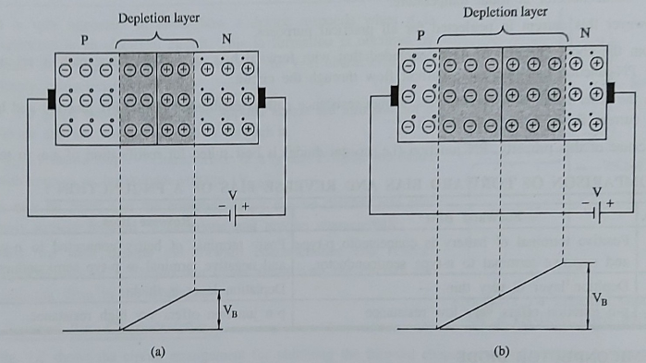
PN junction Reverse Bias

Slide 24
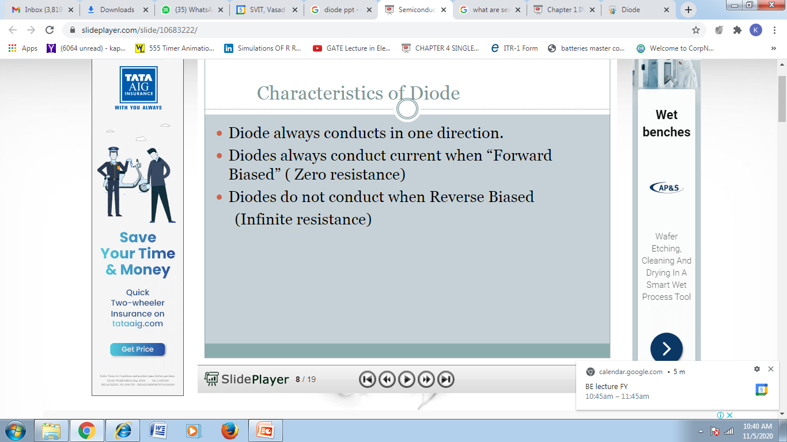
Characteristics Of Diode

Slide 25
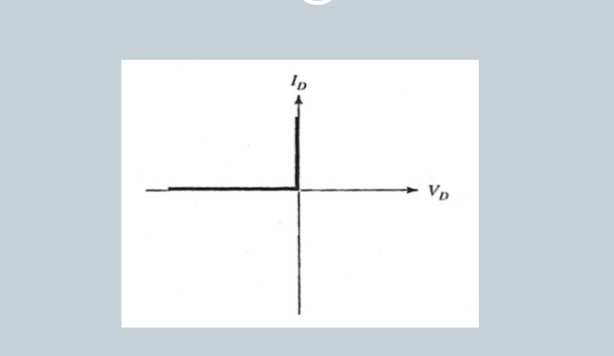

IV Characteristics Of an ideal diode

Slide 26
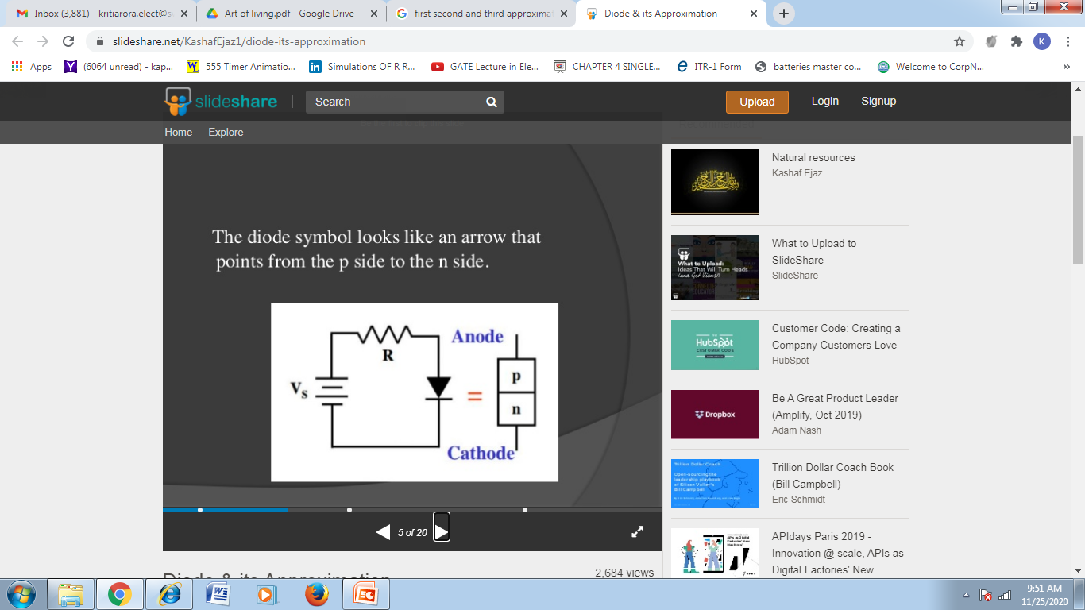
Diode

Slide 27
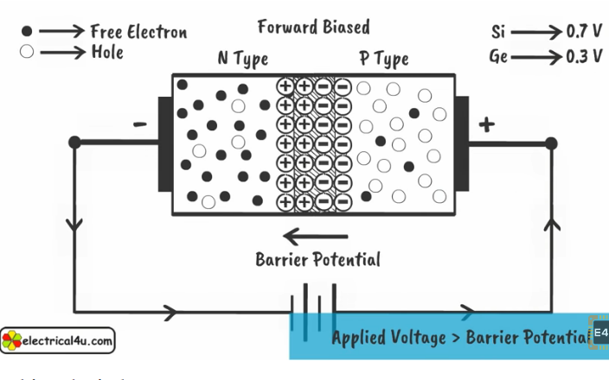
Forward Bias

Slide 28
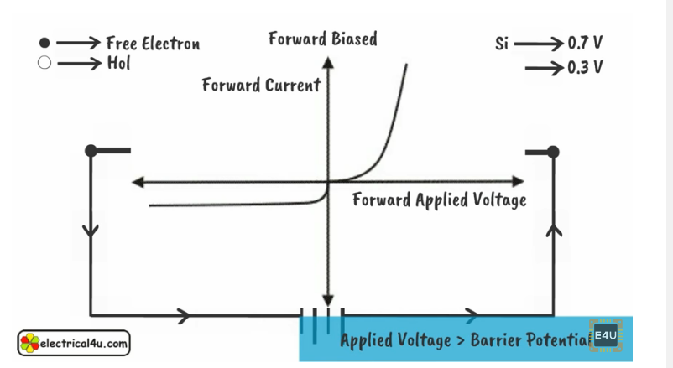
Forward Bias

Slide 29
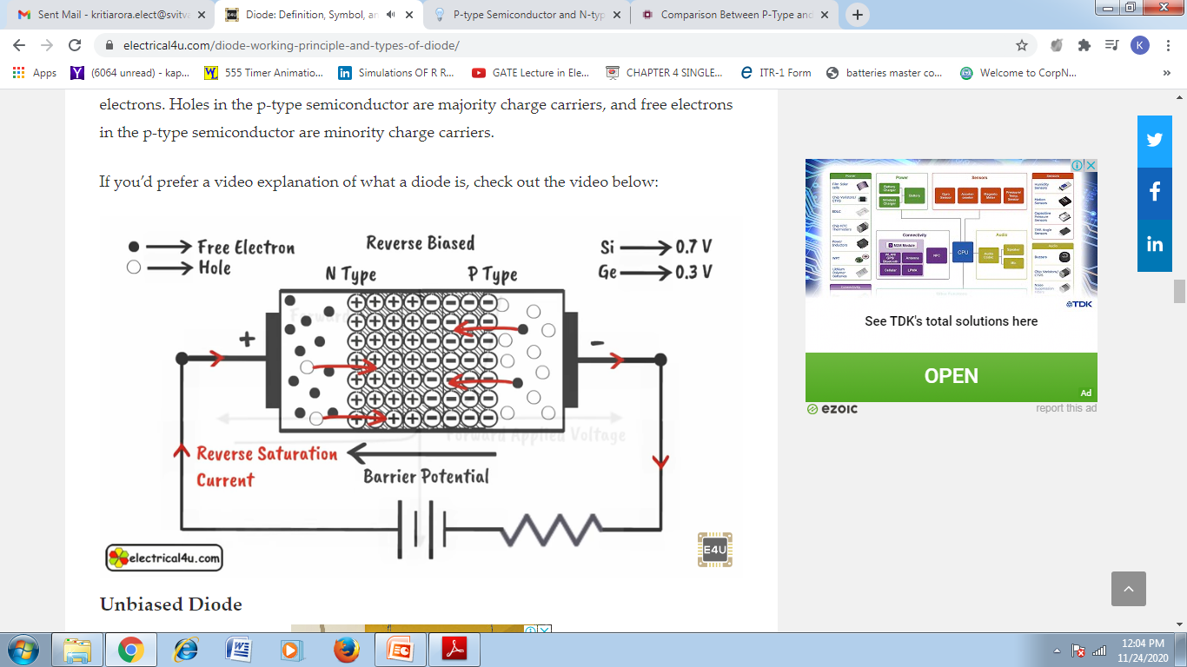
Reverse Bias

Slide 30
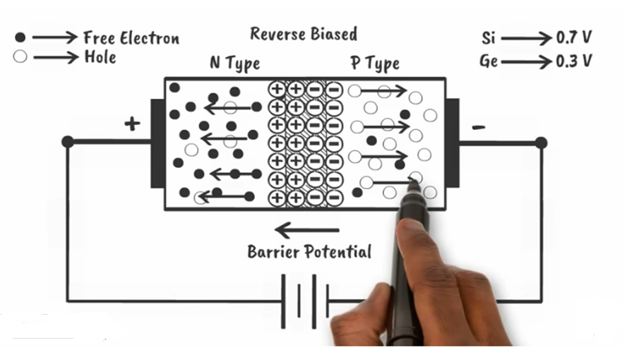
Reverse Bias

Slide 31
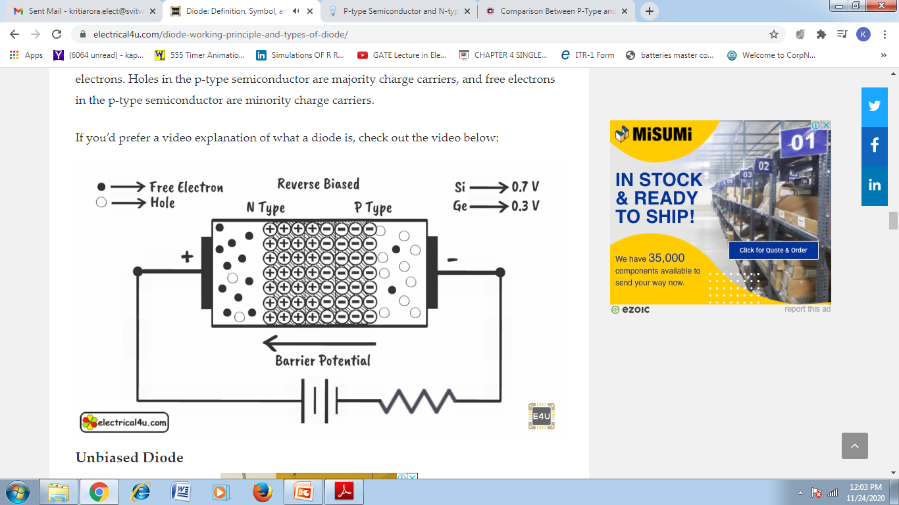
Reverse Bias

Slide 32
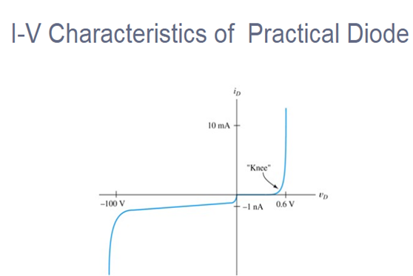

Slide 33
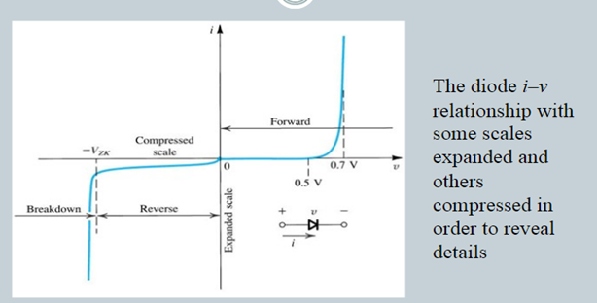

Slide 34
What is Diode Approximations?
Definition: The approximation technique that helps in analyzing the various initial criteria of the diode can be defined as Diode Approximations.
Each approximates relates from assuming ideal conditions to reaching practical ones.

Slide 35
Ideal Diode [First Approximation ]
In the first situation of approximating the Diode considered to be in Ideal mode. It means there is zero Internal Resistance and doesn’t have any consuming Voltage. This indicates that Diode in Ideal mode is a Perfect Version of Switch.
When the ideal diode is forward bias it is a closed switch..
When it is reverse bias it is an open switch.

Slide 36
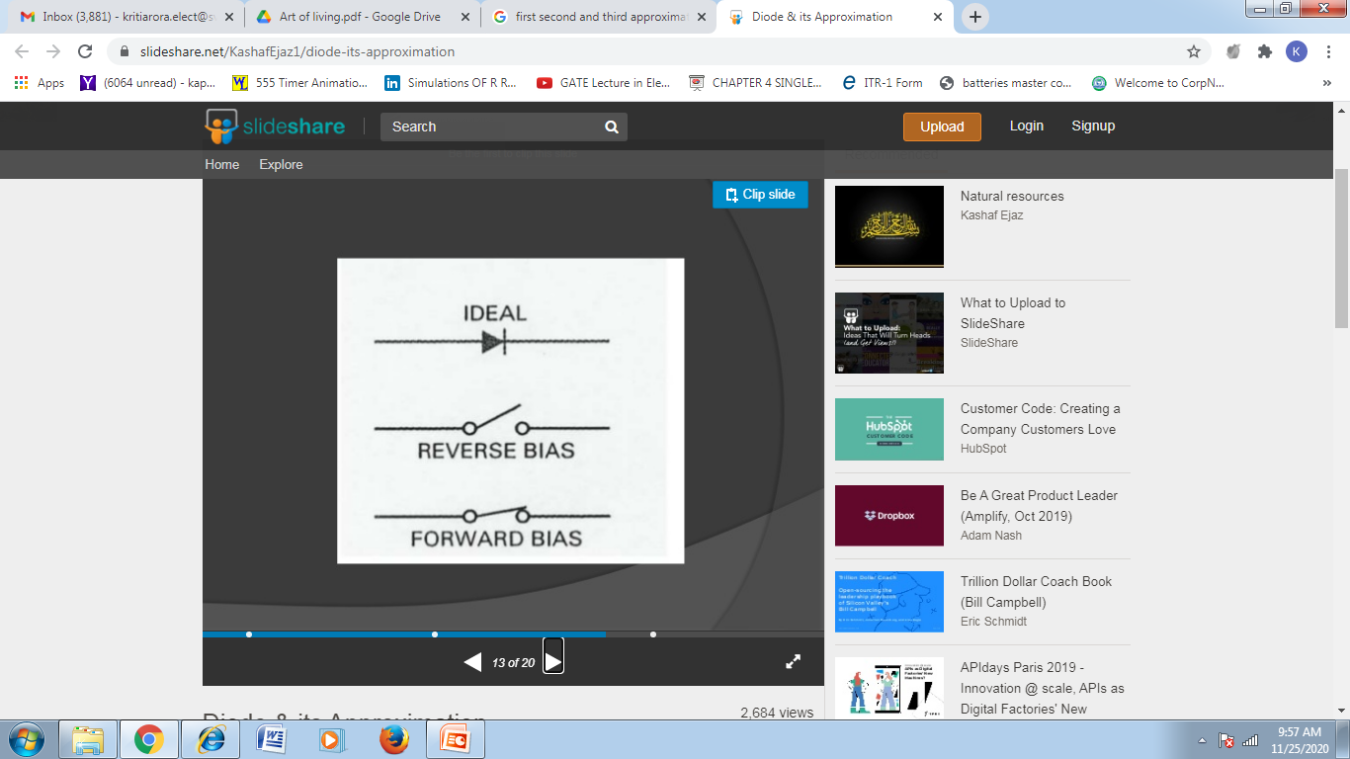
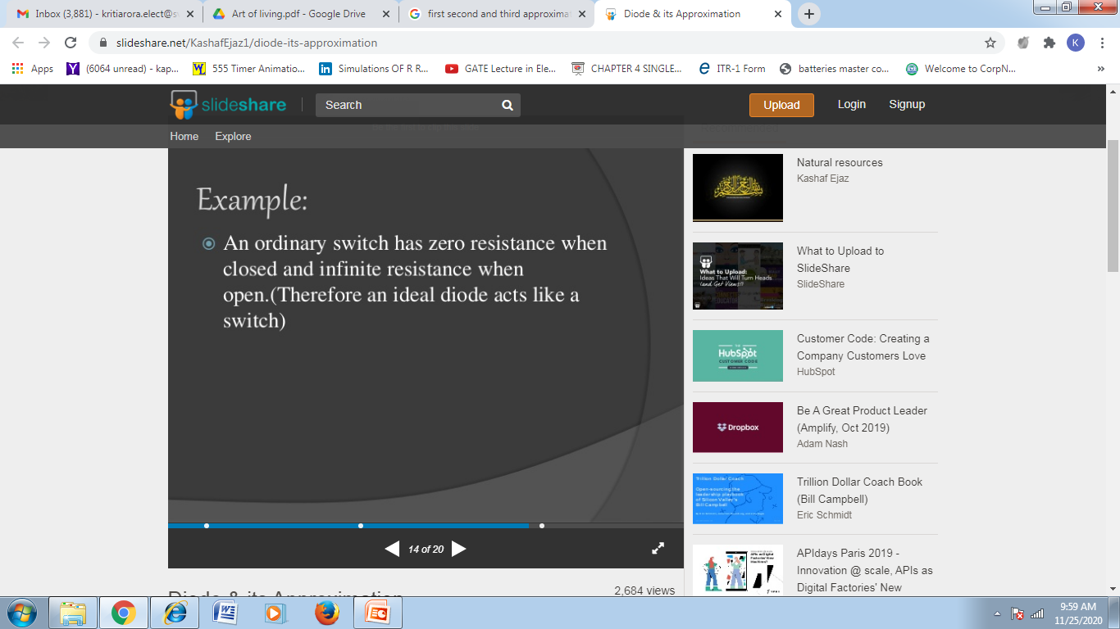

Ideal Diode [First Approximation ]

Slide 37
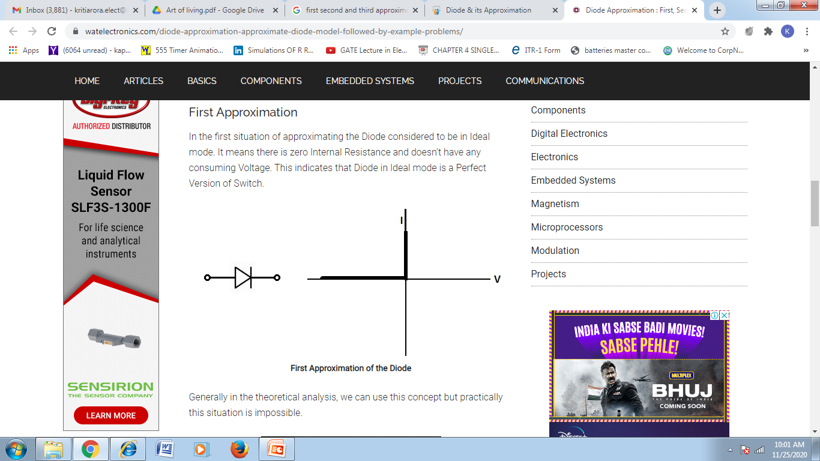
Ideal Diode [First Approximation ]

Slide 38
2nd approximation
The first condition is about the Ideal Mode of the Diode. It doesn’t require any initial voltage to turn it into ON. But in the second case, it prefers a certain amount of voltage to turn the Diode ON.
In this case of Second Approximation, the Diode can be made to function as a switch by applying the cut-off voltages. For example, if the silicon is the semiconductor material used. Then in this case, if the voltage applied exceeds 0.7 volts the Diode is in ON mode. If it is below the minimum voltage then the diode is in OFF mode.
Therefore, in this way diode acts as a switch.

Slide 39
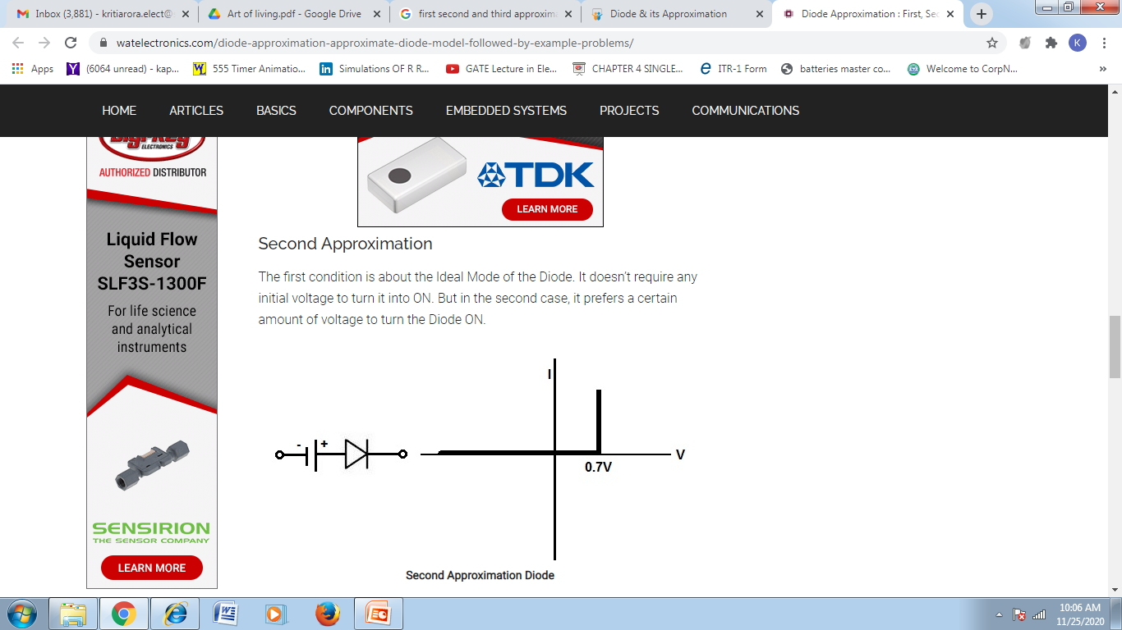
2nd approximation

Slide 40
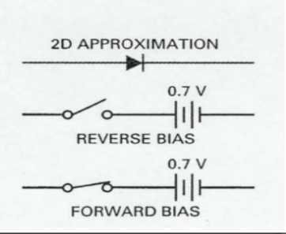
2nd approximation

Slide 41
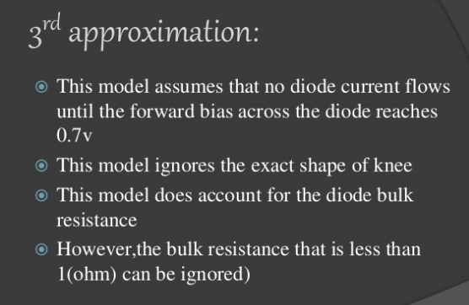
3rd Approximation

Slide 42
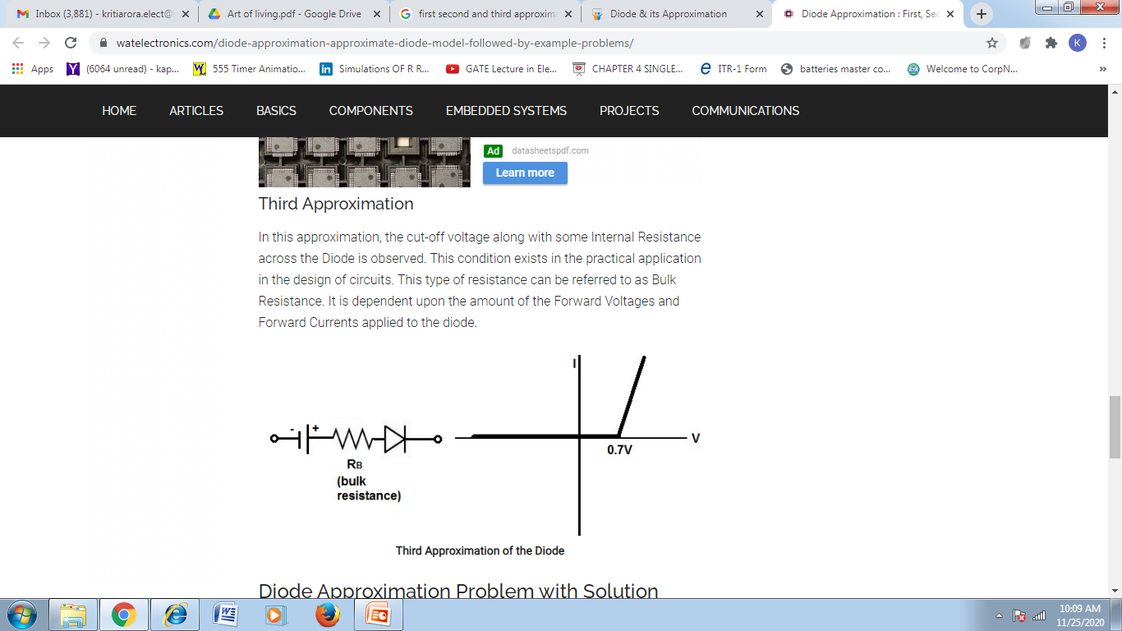
3rd Approximation

Slide 43
PN junction Forward Bias

Slide 44
PN junction Reverse Bias

Slide 45
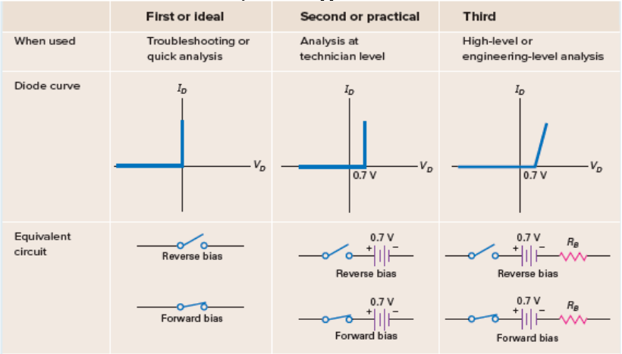
Diode Approximation

Slide 46
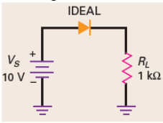
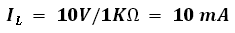
Example of Diode approximation
Use the ideal diode to calculate the load voltage , load current and diode power
Solution :
Load voltage V_{L} = 10 V = Vs - V_{D}
With Ohm’s law, the load current is :
The diode power is
= 0

Slide 47
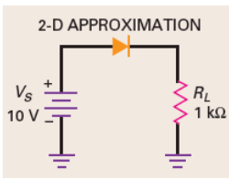
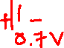
Example of Diode approximation
Use the second approximation to calculate the load voltage, load current, and diode power
Solution :
Since the diode is forward biased, it is equivalent to a battery of 0.7 V. This means that the load voltage equals the source voltage minus the diode drop:
Load voltage
With Ohm’s law, the load current is :
The diode power is

Slide 48
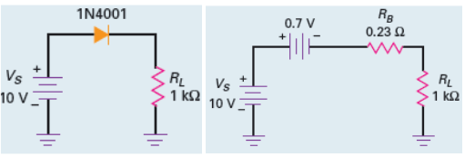
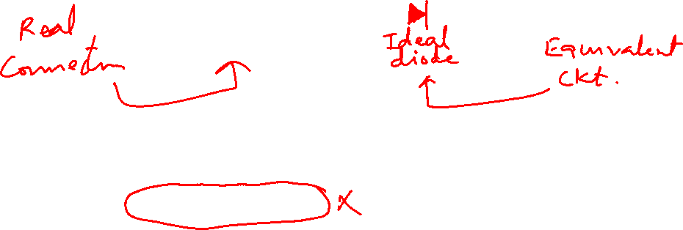
Example of Diode approximation
The 1N4001 of has a bulk resistance of 0.23 Ω. What is the load voltage, load current, and diode power?
Solution :
Since the diode is forward biased, it is equivalent to a battery of 0.7 V. This means that the load voltage equals the source voltage minus the diode drop:
Load voltage
With Ohm’s law, the load current is : IL = (Vs-Vd)/(RB +RL)
VL = Vs-Vd – ILRB) = 9.28V
The diode power is

Slide 49
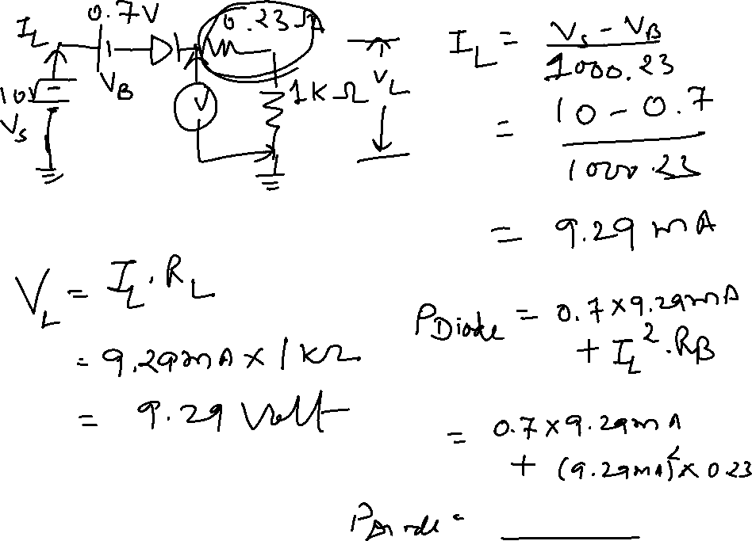

Slide 51
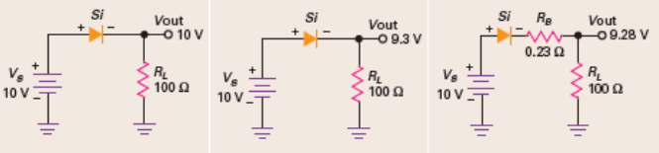

Slide 52
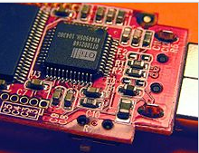
Surface mount Technology
Surface-mount technology (SMT) is a method in which the electrical components are mounted directly onto the surface of a printed circuit board (PCB).
An electrical component mounted in this manner is referred to as a surface-mount device (SMD).
In industry, this approach has largely replaced the through-hole technology construction method of fitting components, in large part because SMT allows for increased manufacturing automation which reduces cost and improves quality - It also allows for more components to fitted to a given area.
Both technologies can be used on the same board, with the through-hole technology often used for components not suitable for surface mounting such as large transformers and heat-sinked power semiconductors

Slide 53
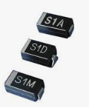
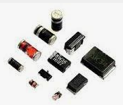

Surface mount Diode
Surface – mount (SM) diodes can be found anywhere there is a need for diode applications.
SM diodes are small, efficient, and relatively easy to test, remove, and replace on the circuit board.
The length and width of the SM package are related to the current rating of the device. The larger the surface area, the higher the current rating.
Increasing the surface area of an SM -style diode increases its ability to dissipate heat. Also, the corresponding increase in the width of the mounting terminals increases the thermal conductance to a virtual heat sink made up of the solder joints, mounting lands, and the circuit board itself.

Slide 54


Surface mount Diode

